Slide 1
SQL Project
Submitted: Thiraviya.r

Slide 2
What is My SQL ?
SQL stands for structured query language (sql) is fundamentally, a programming language designed for accessing , modifying and extracting information from relational databases.
Helps you to access and manipulate database.
An official SQL standard was adopted by the American national standards institute (ANSI) in 1986, with the international organization for standardization (IS0) adopting the standard in 1987.

Slide 3
What is Database ?
A database is an organized collection of structured information, or data, typically, stored electronically in a computer system.
A database is usually controlled by a database management system(DBMS).
The data can then be easily accessed, managed, modified, update, controlled, and organized.
Most databases use structured query language (SQL) for writing and querying data.

Slide 4
What is RDBMS ?
A relational database management system (RDBMS) is a database management system (RDBMS) that is based on the relational model as introduced by E.F.codd.
Most popular commercial and open sourse databases currently in use are based on the relational model.
A short definition of an RDBMS may be a DBMS in which data is stored in the form of tables and the relationship among the data is also stored in the form of tables.

Slide 5
Difference Between DBMS and RDBMS
DBMS
Data is stored as a file.
Its support single users.
Its does not support client server architecture
RDBMS
Data is stored in the form of tables.
Its supports multiple users.
It support client-server architecture
Data is stored in the form of tables which are related to each other.
No relationship between data.

Slide 6
Features of MySQL ?
Relation database management system (RDBMS)
Easy to use
Storing data is secure
Open source & free to download
Compatible on many operating systems

Slide 7
Commands
Data query language (DQL) commands
Data definition language (DDL) commands
Data manipulation language (DML) commands

Slide 8
Different types of data types
Numeric Types
Character String Types
Date and Time Types
Boolean Types
Binary Data Types
Enumerated Types
Geospatial Types
JSON Types
Custom and User Defined Types

Slide 9
Numeric data type
INT : Integer data type for storing whole numbers.
BIGINT : Large integer data type for very large whole numbers.
SMALLINT : Small integer data type for small whole numbers.
DECIMAL/NUMERIC : Fixed-point numeric data type that stores exact numeric values with a specified precision and scale.
FLOAT/REAL : Floating-point numeric data type for approximate numeric values with a specified precision.

Slide 10
Date and time
DATE : Date data type for storing dates (Year,month,day).
TIME : Time date type for storing time of day.
DATETIME/TIMESTAMP : Date and time data type for storing both date and time information.
INTERVAL : Represents a period of time.

Slide 11
Data query language (DQL) commands
SELECT- Retrieves data from one or more tables.
FROM- Specifies the table(s) from which to retrieve data.
WHERE-Filters data based on specified conditions.
GROUP BY-Groups data based on one or more columns.
HAVING-Filters grouped data based on conditions.
ORDER BY-Sorts the result set based on one or more columns.
JOIN-Combines rows from two or more tables based on a related column.

Slide 12

Creating database ,use database , drop database , show database
Create database:-
Show database:-
show all created databases
show databases;
Drop database:-
to drop the database
Drop database;

Slide 13
Create table & show table

Slide 14
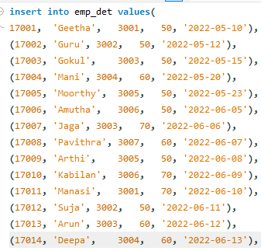
Insert values

Slide 15
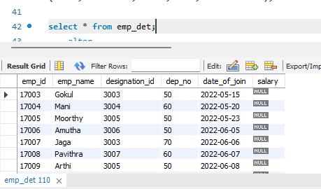
Select query

Slide 16
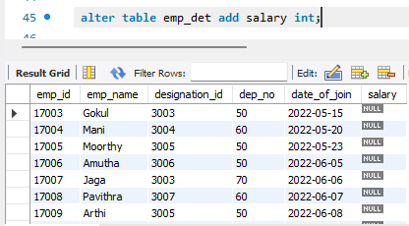
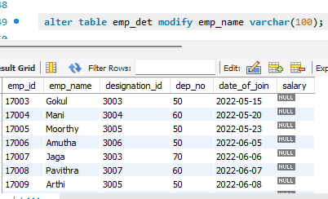
Alter table statement
Add
Modify

Slide 17
SQL General Function
Where
Or
And
In
Not in
>=
<=
<>(Not in)
!
Count
Distinct
Count with Distinct
Order by ASC
Order by DESC
Group by
Limit
Desc limit
Like
Not like
Between

Slide 18
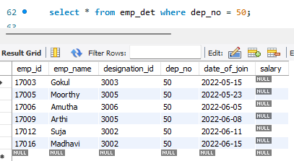
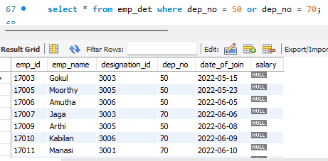
Where and or query
Where query
Or query

Slide 19
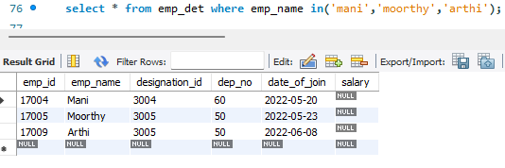
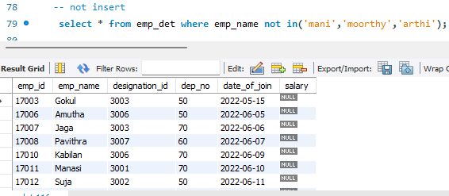
In query and not in query
In query
Not in query

Slide 20
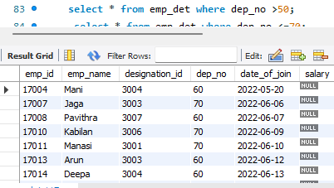
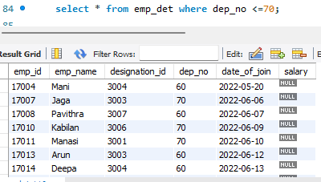
<,> & =>,=<
> query
<= query

Slide 21
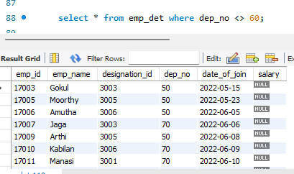
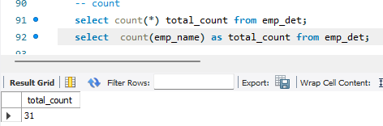
<> And count
<> query
Count query

Slide 22
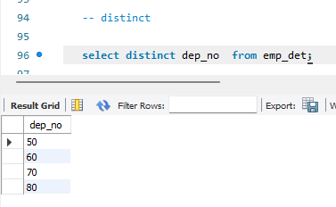
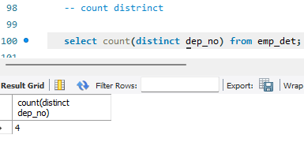
Distinct and count distinct query

Slide 23
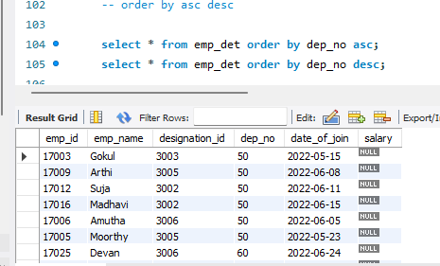
Order by

Slide 24
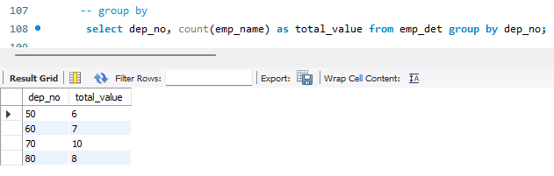
Group by

Slide 25
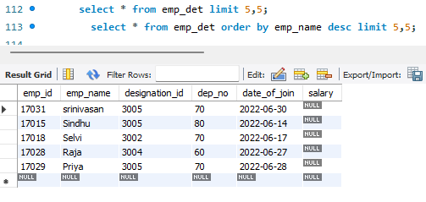
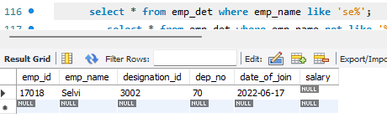
Limit and like query
Limit query
Like query

Slide 26
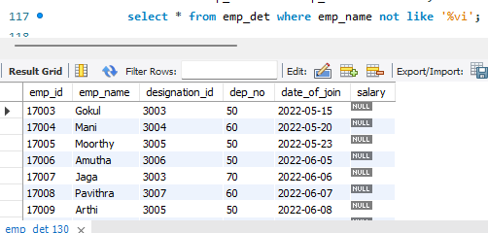
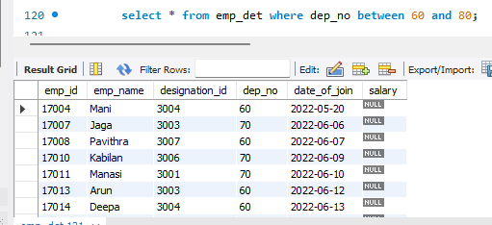
Not like and between query
Not like query
Between query

Slide 27
String Function
Lcase(Lower Case)
Ucase(Upper Case)
Right
Left
Concat
Trim
Char_Length
Mid
Length

Slide 28
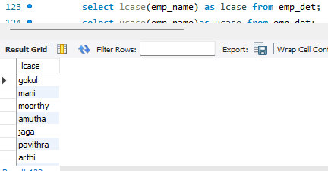
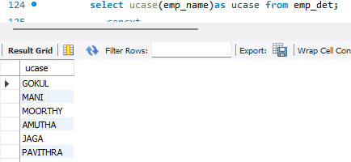
Lcase and ucase
Lcase
ucase

Slide 29
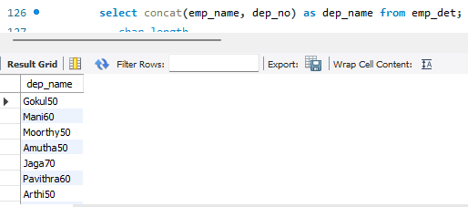
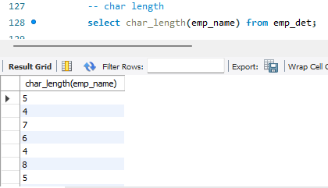
Concat and char length
Concat query
Char length

Slide 30
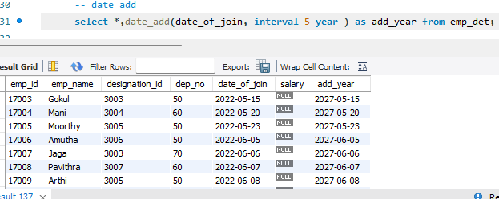
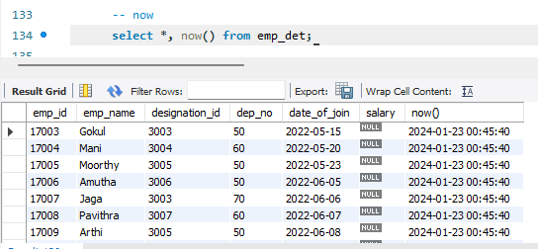
Date functions
Date add
now

Slide 31
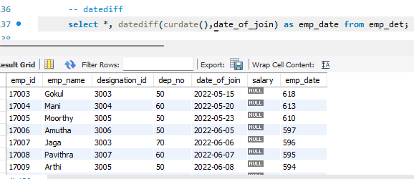
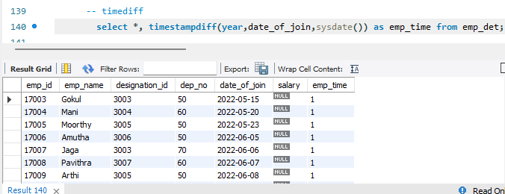
Datediff and timestampdiff
Datediff
Timestampdiff

Slide 32


Update and delete query

Slide 33
SQL calculation functions
Sum
Average
Minimum
Maximum
Count
Round

Slide 34
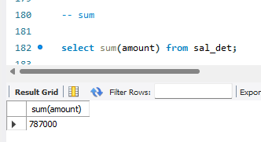
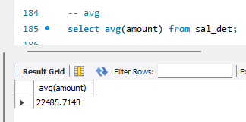
Calculation functions

Slide 35
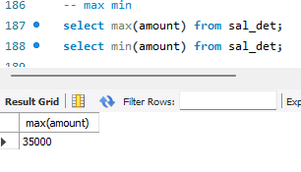
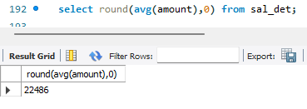
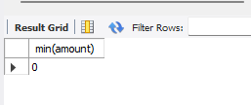
Maximum , minimum and round

Slide 36
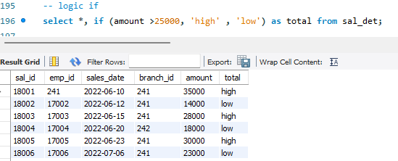
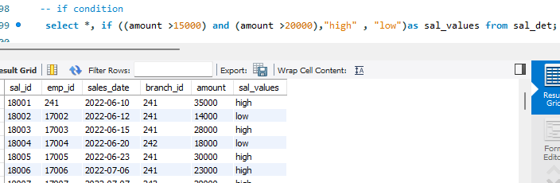
Logical function

Slide 37
Types of Join query
Inner query
Left query
Right query
Cross
query
Full outer
query

Slide 38
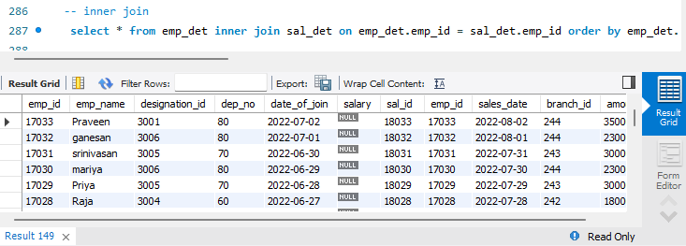
Inner query

Slide 39
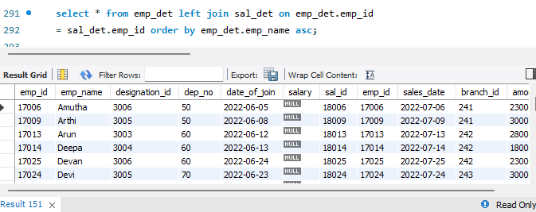
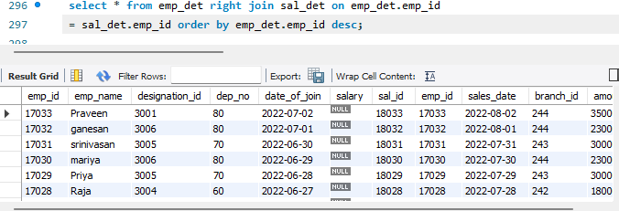
Left and right join
Left join
Right join

Slide 40
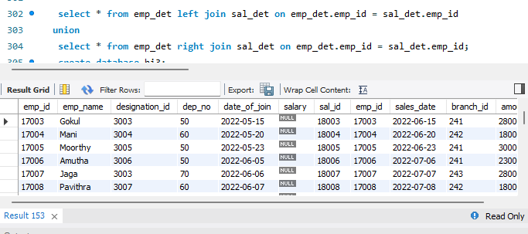
Union join

Slide 41
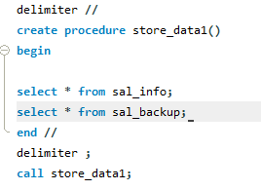
Stored procedures
A stored procedure is a prepared SQL code that you can save, so the code can be reused over and over again.

Slide 42
Trigger
Trigger:- A database trigger is stored program which is automatically fire executed when some events occur
Types of trigger:- * Row level trigger
* Statement level trigger
Trigger timings:-
After insert
Before insert
Before update
After update
Before delete
After delete

Slide 43
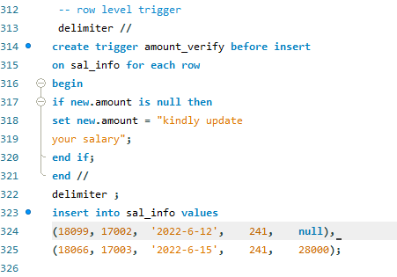
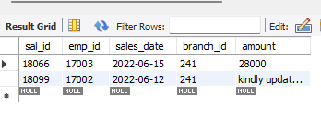
Row level trigger

Slide 44
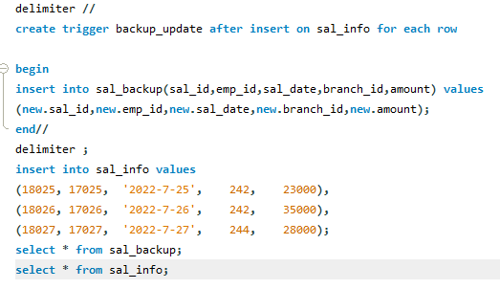
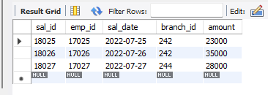
Statement level trigger

Slide 45
Thank you

